Slide 1



State of the District Schools
September 26, 2024

Slide 2
Curriculum & Instruction
New Programs
iReady Math – grades k-6
Algebra – grades 7-11
World language

Slide 3
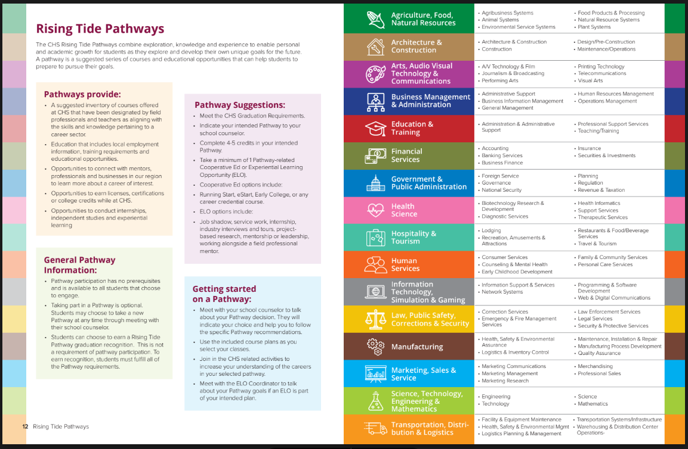

Slide 4
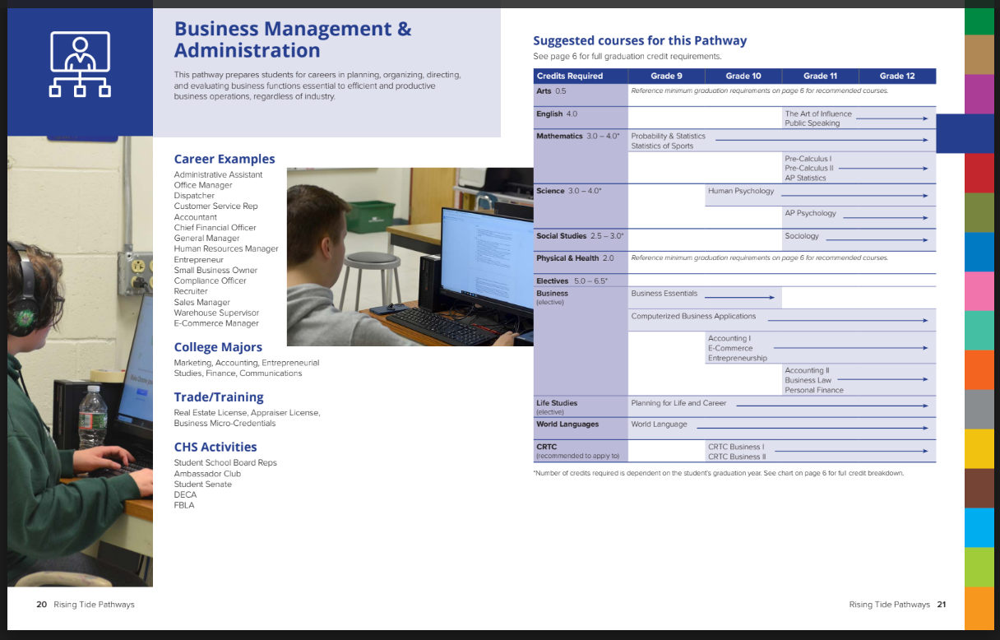

Slide 5
Job Fair - Partnership
Chamber, Concord High, CRTC
54 business with 150+ business professionals
800 students

Slide 6
Grants
Social Emotional Learning
Children’s Mental Health
Initiative - $3.38M
Project AWARE - $6.46M

Slide 7
Communication

Slide 8
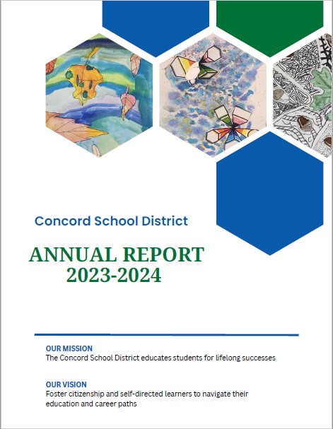

Slide 9
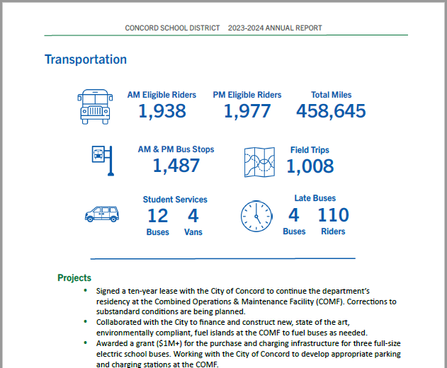

Slide 10
Financial

Slide 13
TAX YEAR | SCHOOL RATE VALUATION | LOCAL | STATE | LOCAL & STATE EDUCATION TOTAL
2014 | -0.55% | 4.13% | 7.88% | 4.80%
2015 | 2.33% | 4.74% | 0.38% | 3.94%
2016 | 2.24% | 4.53% | -8.43% | 2.24%
2017 | 2.63% | 4.25% | -3.77% | 2.98%
2018 | 3.84% | 1.21% | -10.87% | -0.58%
2019 | 4.08% | -1.04% | -8.78% | -2.07%
2020 | 6.35% | -0.98% | 14.44% | 0.93%
2021 | 9.95% | -5.10% | -22.43% | -7.53%
2022 | 0.84% | 7.70% | -27.11% | 3.61%
2023 | 0.78% | 1.42% | 29.75% | 3.76%
10 Year Average | 3.25% | 2.09% | -2.89% | 1.21%

Slide 14
Capital Projects
HVAC
Safety

Slide 15
Middle School Project

Slide 16
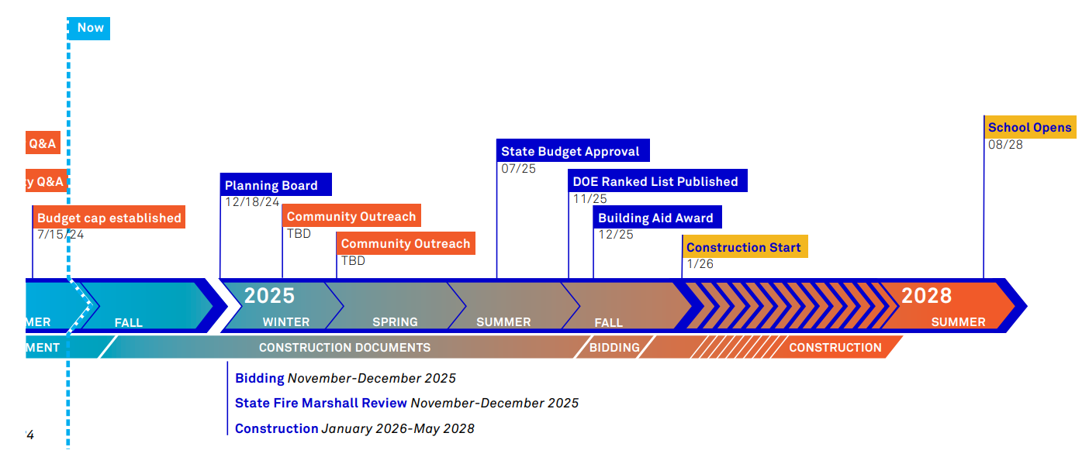
Timeline

Slide 17
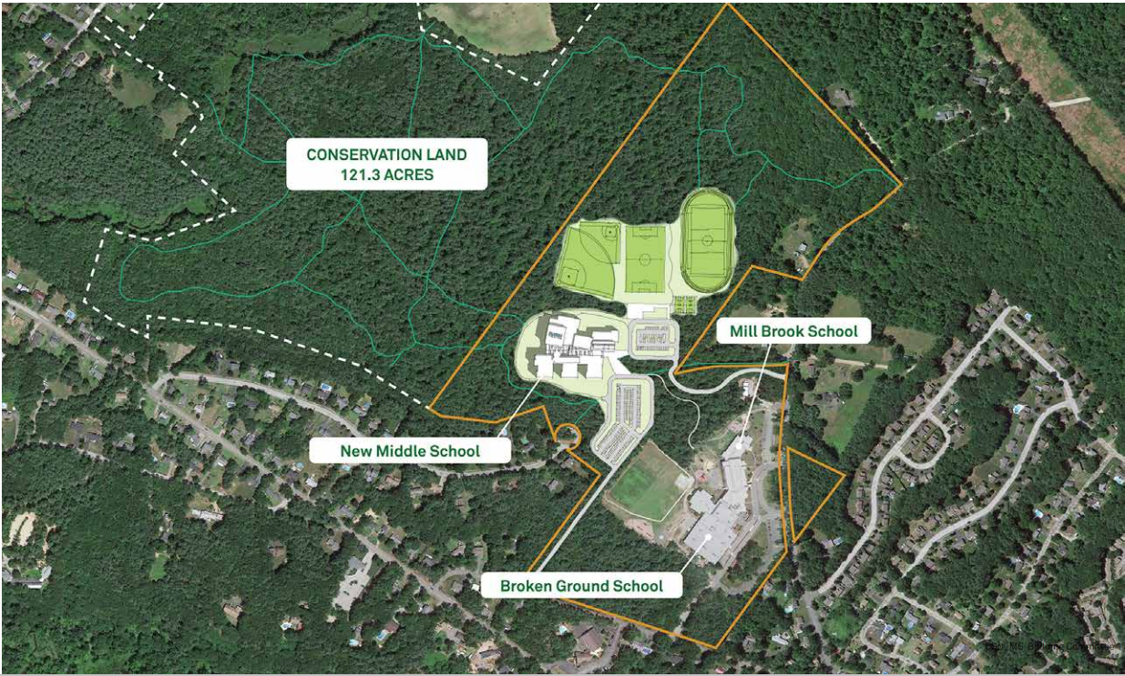

Slide 18
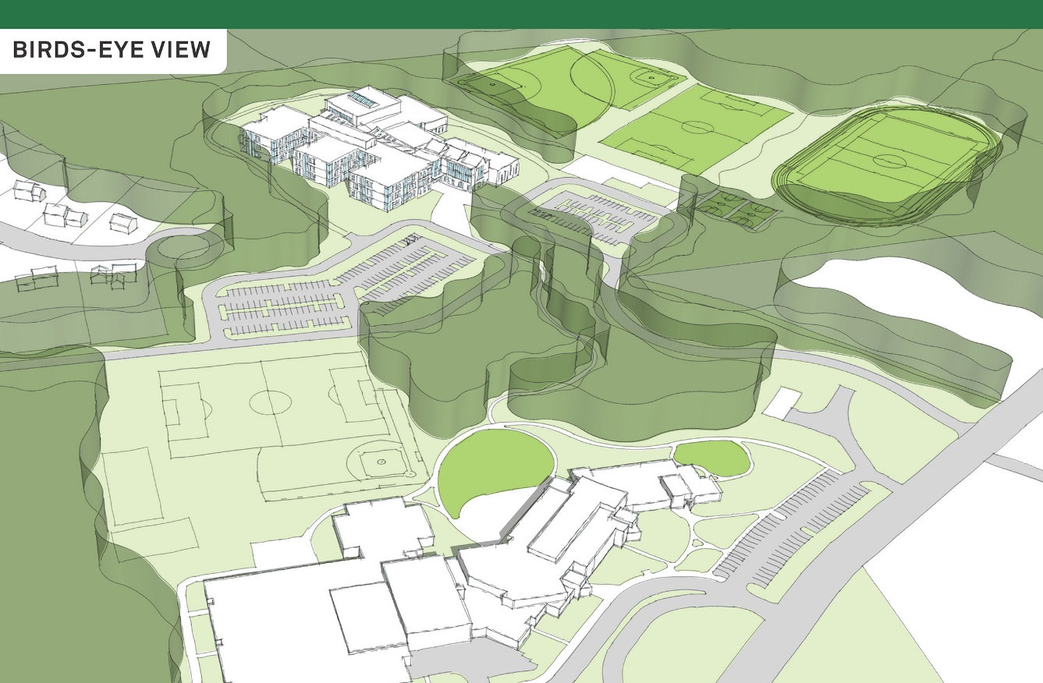

Slide 19
New Middle School – Facilities Trust Fund
New Middle School
State Aid & Facility Trust Fund
Board uses Facility Trust Fund to mitigate tax impact
Project Cost: $152,055,963
Tax impact:
$1.08 /per thousand (1st year)
Property assessed at $350k:
Year 1: $378
Year 2: $368
Assumes state building aid
Concord pays 60% of the cost, state pays 40% of the eligible costs
Board uses Facility Trust Fund to mitigate tax impact
Project Cost: $152,055,963
Cost after State Aid: $112,055,963
Tax impact: $0.42/per thousand
Property assessed at $350k:
Year 1: $147
Year 2: $144
Notes:
No Trust Fund
Year 1: $648
Year 2: $592

Slide 20
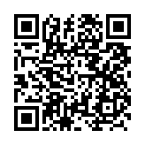
Middle School Project Information
https://www.sau8.org/page/middle-school-project

Slide 21
Kathleen Murphy, Superintendent
Pamela Walsh, President
Board of Education
Jack Dunn, Business Administrator

